Slide 1
Problem Statement
Introduction to GenAI and simple LLM inference on CPU and finetuning of LLM model to create a custom Chatbot

Slide 2
Unique Idea Brief (Solution)
The unique idea used in building the custom chatbot is that it leverages a combination of generative and retrieval-based approaches for conversation response generation.
Generative Pre-training (GenAL): This involves training a large language model on a massive dataset of text and code. This allows the model to generate creative text formatsand answer your questions in an informative way.
Simple LLM Inference on CPU: This refers to running a basic version of a large language model directly on a central processing unit (CPU). This enables real-time inference for chatbot conversations, without needing a powerful graphics processing unit (GPU).
Fine-tuning of LLM model to create a custom Chatbot: This involves taking a pre-trained large language model and then tailoring it to a specific domain or task. In the case of a chatbot, this involves training the model on a dataset of conversation prompts and responses. This customization allows the chatbot to generate responses that are more relevant to the conversation at hand.

Slide 3
Unique Idea Brief (Solution)
RetrievalQA: This component suggests the chatbot can also retrieve information from a knowledge base to answer questions comprehensively. This can be useful for providing factual information that is not generated by the large language model itself.
Overall, the unique idea behind this chatbot is that it combines multiple techniques to generate responses. It can leverage the creativity of a large language model, the efficiency of CPU-based inference, and the factual accuracy of a knowledge base.
This chatbot takes mental health related issues as input and provides with an answer. This project is perfect for resolving queries of those people who have little to no knowledge about mental health and the issues realted to it. Our project also helps spread awareness and answers the question people might feel embarassed to ask in person. The questions and answers are intended to assist individuals in understanding various aspects of therapy and mental health.

Slide 4
Features Offered
The features/functionalities offered by the chatbot are:
Natural Language Processing (NLP): Including a CSV loader, FAISS, and Hugging Face Transformer suggests the chatbot can process and understand natural language. This could allow it to understand a user's intent and respond accordingly.
Large Language Model (LLM): A Google PaLM component suggests the chatbot may use a large language model to generate responses. This could allow it to provide more comprehensive and informative answers.
Question Answering: Including a RetrievalQA component suggests the chatbot may be able to answer questions comprehensively, potentially finding relevant information from a knowledge base.
Identify Key Elements: This step involves identifying the most important words or phrases in the user query, which could be nouns, verbs, or adjectives.

Slide 5
Features Offered
Access CSV File(s): This suggests the system can retrieve information from comma-separated values (CSV) files. CSV files are a common way to store data in a tabular format.
Read CSV Data: In this stage, the system reads and processes the data retrieved from the CSV file.
Data Processing: This is a general step that could encompass a variety of operations depending on the system’s purpose. It might involve calculations, filtering or transforming the data in some way.
The chatbot may be able to hold conversations with users, comprehensively answer their questions, and potentially use a large language model to generate responses.

Slide 6
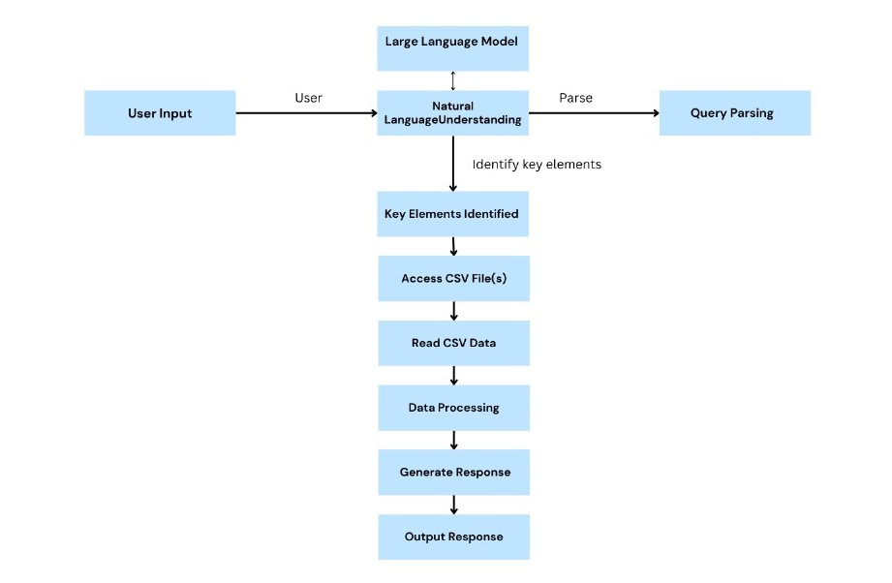
Process flow

Slide 7
Process flow
Fine-tuning a pre-trained LLM involves adapting it to a specific domain or task, such as optimizing inventory management, by training it further on a relevant CSV dataset. This enhances the model's ability to generate accurate and context-specific responses for the intended application.
Steps in the Flow Diagram:
User Input: The user initiates a query or command related to CSV data.
Natural Language Understanding (NLU): Chatbot uses NLU techniques to understand and parse the user's query, identifying key elements such as columns, filters, or operations.
Large Language Model: A sophisticated artificial intelligence designed to understand and generate human-like text based on the input it receives. These models are trained on vast amounts of text data to learn patterns, semantics, and syntax of human language. They can perform a variety of language-related tasks such as text generation, translation, summarization, and answering questions.
Query Parsing: The parsed query is processed to extract specific details relevant to accessing and manipulating CSV data.

Slide 8
Process flow
Access CSV File(s): Chatbot accesses the CSV file(s) specified in the query, ensuring it can read and process the data.
Read CSV Data: The chatbot reads the data from the CSV file(s) into memory for further processing.
Data Processing: Based on the parsed query and retrieved data, the chatbot performs operations such as filtering, aggregation, or calculations.
Generate Response: Using the processed data, the chatbot generates a response that answers the user's query or fulfills their request.
Output Response: Finally, the chatbot outputs the response to the user, which may include presenting data summaries, insights, or confirming the execution of requested operations.
This flow diagram illustrates a structured approach for an LLM-based chatbot to interact with CSV files, ensuring clarity in how user queries are processed, and data is handled throughout the interaction

Slide 9
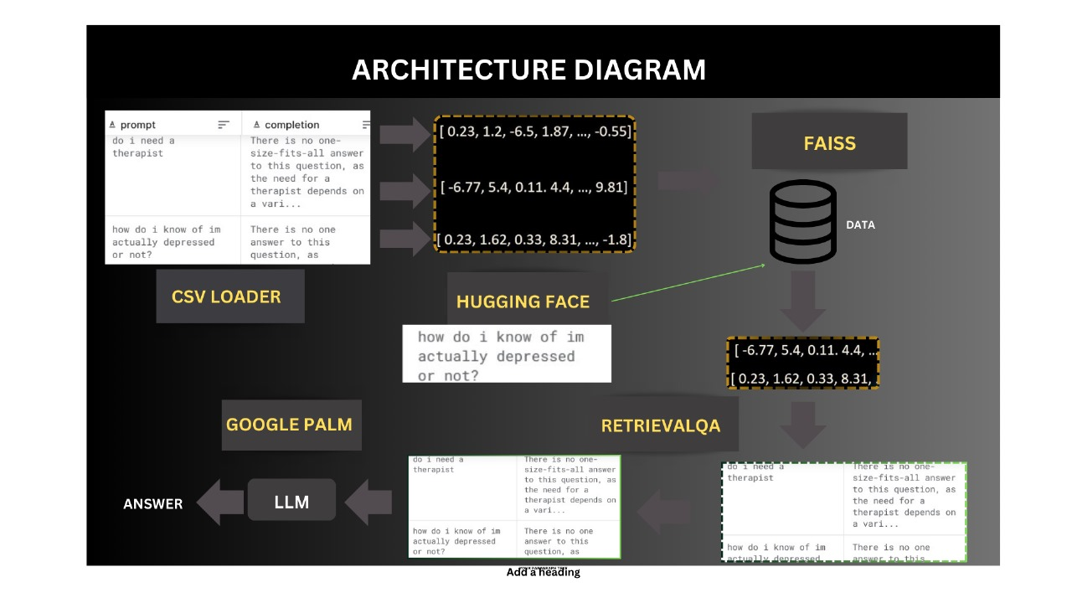
Architecture Diagram

Slide 10
Technologies used
The following technologies have been used in building the chatbot:
langchain
Python-dotenv
Streamlit
Tiktoken
faiss-cpu
Protobuf
google-generativeaitransformers
Torch
sentence-transformers
InstructorEmbedding

Slide 11
Team members and contribution:
Frontend : Attyansha & Jaysi
Role : Designing and implementing the user interface, ensuring seamless user interactions, and integrating the frontend with backend services.
Database and Pre Training : Rudransh & Attyansha
Role : Training a large language model on a massive dataset of text and code. This allows the model to generate creative text formats and answer your questions in an informative way.
Fine-tuning and RetrievalQA: Jaysi & Rudransh
Role : Training the model on a dataset of conversation prompts and responses , retrieve information from a knowledge base to answer questions comprehensively.

Slide 12
Team members and contribution:
Collaborative Contributions :
Team Meetings: Regularly scheduled meetings to discuss progress, address challenges, and plan next steps.
Documentation: Collaborative documentation of the project's development process, including code comments, user guides, technical specifications and final presentation.
Testing and Feedback: Continuous testing and feedback loop to refine the chatbots performance and user experience.

Slide 13
Conclusion
A chatbot utilizing GenAI for simple LLM inference on CPU, coupled with fine-tuning of the language model, offers a customizable and efficient solution. This approach blends the accessibility of GenAI's platform with the enhanced capabilities of fine-tuned LLM models, enabling the creation of a personalized chatbot capable of understanding nuanced queries and providing accurate responses. This combination ensures a versatile tool suitable for diverse conversational applications, leveraging both computational efficiency and tailored linguistic proficiency.

